Slide 1



DATA MINING PRESENTATION
Hawk Hotel Consultants
Notes:
Mollie: 1-7
Molly: 8-13
Regan: 14-17
Lindsey: 18-22

Slide 2
01.
BACKGROUND INFORMATION
02.
OUR GOALS
03.
SOLUTION & RECOMMENDATIONS
04.
LIMITATIONS
AGENDA

Slide 3

01.
BACKGROUND INFORMATION

Slide 4

PROBLEM DESCRIPTION
Industry average was 12.8% in 2018
Find strategies to keep hotel fully booked
Target high cancellations & build customer loyalty
33% of rooms were cancelled
in 2017 & 2018
BACKGROUND
INFORMATION
OUR
GOAL
SOLUTION
LIMITATIONS
(Raza, 2023 & Revenue Hub, 2020)

Slide 5
02.
OUR GOALS

Slide 6

BUSINESS GOAL
Keep hotel rooms fully booked to maximize profits
Maintain customer satisfaction
BACKGROUND
INFORMATION
OUR
GOAL
SOLUTION
LIMITATIONS

Slide 7
BUSINESS GOAL
DATA MINING GOAL
Keep hotel rooms fully booked to maximize profits
Maintain customer satisfaction
Determine most important factors that lead to cancellations
Build model that predicts cancellations
BACKGROUND
INFORMATION
OUR
GOAL
SOLUTION
LIMITATIONS

Slide 8
03.
SOLUTIONS & RECOMMENDATIONS

Slide 9
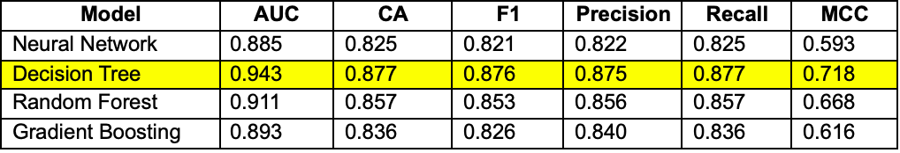
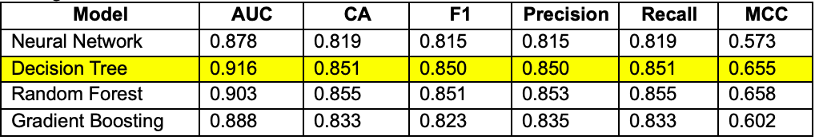
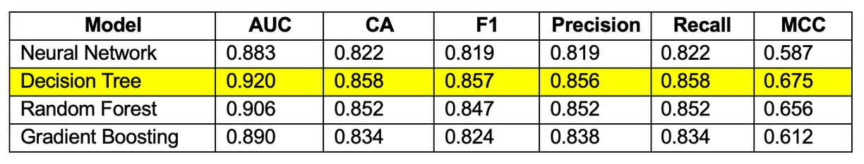
SOLUTION #1
Training
Testing
Predictive model - classifies as “cancel” or “not cancel”
Decision tree provides the highest AUC and does not overfit
Cross Validation (10 Fold)
BACKGROUND
INFORMATION
OUR
GOAL
SOLUTION
LIMITATIONS

Slide 10
SOLUTION #1
Decision Tree Model Factors
Number of adults
Arrival month
Number of children
Market segment type
Number of weekend nights
Repeat guest
Number of week nights
# of previous cancellations
Meal plan
# of bookings not canceled
Parking space
Average price per room
Room type reserved
Special requests
Lead time
BACKGROUND
INFORMATION
OUR
GOAL
SOLUTION
LIMITATIONS

Slide 11
SOLUTION #1
Decision Tree Model Factors
Result
Number of adults
Arrival month
Number of children
Market segment type
Number of weekend nights
Likely to cancel
Repeat guest
Number of week nights
# of previous cancellations
Meal plan
# of bookings not canceled
Unlikely to cancel
Parking space
Average price per room
Room type reserved
Special requests
Lead time
BACKGROUND
INFORMATION
OUR
GOAL
SOLUTION
LIMITATIONS

Slide 12

RECOMMENDATION #1
Implement this predictive model onto reservation website to determine the probability of reservation cancellation.
BACKGROUND
INFORMATION
OUR
GOAL
SOLUTION
LIMITATIONS

Slide 13
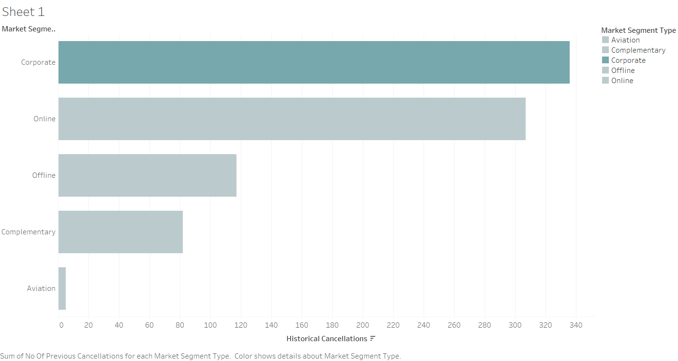
SOLUTION #2
Cancellations have come mostly from corporate groups.
BACKGROUND
INFORMATION
OUR
GOAL
SOLUTION
LIMITATIONS

Slide 14

RECOMMENDATION #2
Target corporate groups by offering incentives and personalized services, or raise cancellation fees to decrease chances of cancellation.
BACKGROUND
INFORMATION
OUR
GOAL
SOLUTION
LIMITATIONS

Slide 15
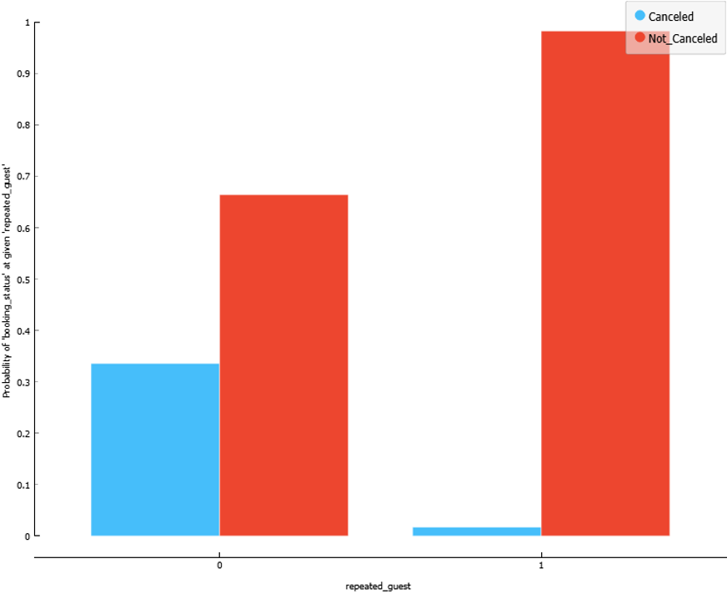
SOLUTION #3
Repeat guests are less likely to cancel their hotel reservations.
BACKGROUND
INFORMATION
OUR
GOAL
SOLUTION
LIMITATIONS
Notes:
Repeat guests & lead time
- I will continue on with our final two solutions and recommendations
- created a bar chart to visualize the probability of cancellations, based on whether or not they are a repeat guest
- as you can see, it is much more likely that a first-time guest will cancel their reservation than a repeat guest. This shows that people who are more loyal to the hotel are less likely to cancel.

Slide 16
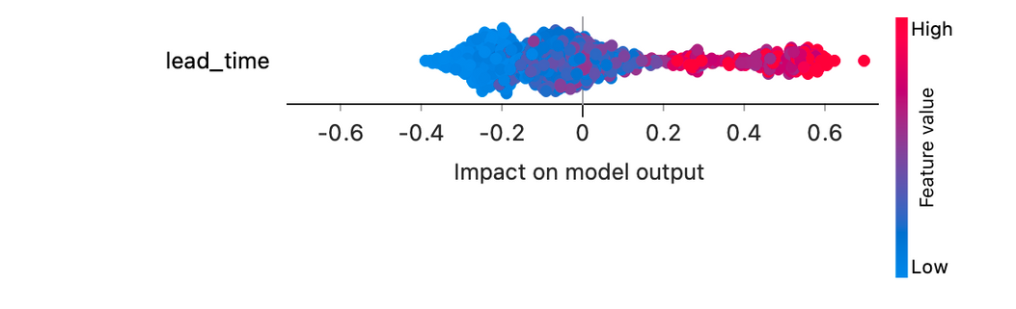
SOLUTION #3
Repeat guests are less likely to cancel their hotel reservations.
Lead time has the greatest impact on guest cancellations.
BACKGROUND
INFORMATION
OUR
GOAL
SOLUTION
LIMITATIONS
Notes:
- Additionally, we used the Explain Model widget to determine the factors that had the greatest impact on whether or not a guest would cancel. We found that lead time was the top factor, which shows that it has the greatest impact on whether or not a guest would cancel. For reference, lead time is the amount of days in advance the reservation was made before the check in date. This visualization shows that the greater the value of lead time (more days in advance the reservation was made), the more likely it would be cancelled.

Slide 17

RECOMMENDATION #3
Create a loyalty program that prioritizes repeat guests in the booking process, allowing them to reserve rooms earlier.
BACKGROUND
INFORMATION
OUR
GOAL
SOLUTION
LIMITATIONS
Notes:
- This analysis led us to our third recommendation: based on the loyalty that repeat guests show, we believe it would be valuable for this hotel to create a loyalty program that prioritizes repeat guests in the booking process, allowing them to reserve rooms earlier. These guests would have priority to book since they are less likely to cancel, while also building more brand loyalty amongst frequent guests.

Slide 18
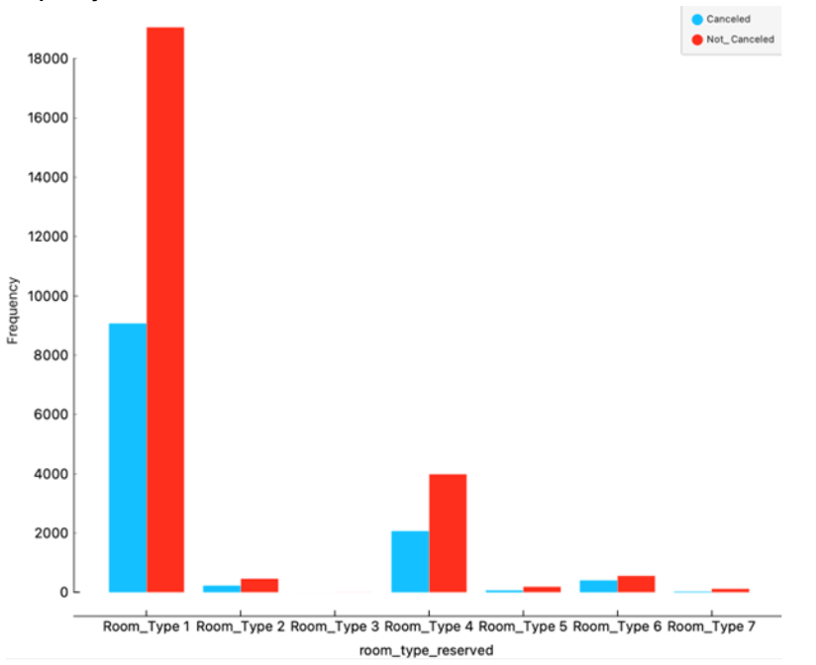
SOLUTION #4
Room Type 1 has the most bookings and the most cancellations.
BACKGROUND
INFORMATION
OUR
GOAL
SOLUTION
LIMITATIONS
Notes:
- Finally, for our last solution, we looked at the impact that room type had on cancellations. The first bar chart we created shows that room type 1 has the most frequent bookings, and the most frequent cancellations. This is followed by room type four, which also sees frequent cancellations.

Slide 19
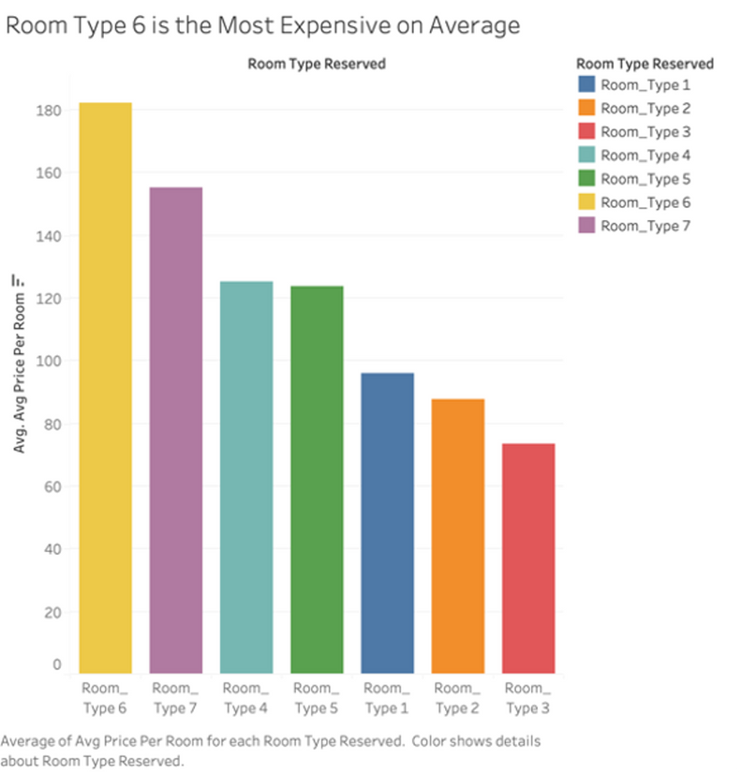
SOLUTION #4
Room Type 1 has the most bookings and the most cancellations.
Room Types 1 and 4 are moderately priced, relative to other rooms.
BACKGROUND
INFORMATION
OUR
GOAL
SOLUTION
LIMITATIONS
Notes:
- Additionally, we found that room types 1 and 4 were moderately priced relative to other room offerings. This shows that extreme price (either low or high) most likely does not have a significant impact on the frequency that room types 1 and 4 are being booked or cancelled.

Slide 20

RECOMMENDATION #4
Restructure what Room Type 1 and Room Type 4 offer guests and how the value proposition is communicated to customers.
BACKGROUND
INFORMATION
OUR
GOAL
SOLUTION
LIMITATIONS
Notes:
- Based on this analysis of room types, we recommend that the hotel restructures what room type 1 and 4 offer guests, as well as how that value proposition is communicated to customers. To fully understand what is going wrong with these rooms, we would need more information from the hotel to see what these rooms are offering or not offering that is causing high numbers of bookings and cancellations. Nonetheless, we see that there's an opportunity with these rooms that should be further explored.
- I'm now going to pass it to Lindsey to wrap up with our limitations and conclusion.

Slide 21
04.
LIMITATIONS

Slide 22

LIMITATIONS
Number of beds, bathroom configurations, and other amenities not provided in dataset
Pre-COVID Data
(2017-2018)
Cancellations are circumstantial
BACKGROUND
INFORMATION
OUR
GOAL
SOLUTION
LIMITATIONS

Slide 23
05.
CONCLUSION

Slide 24




CONCLUSION
Implement predictive model on website to determine probability of reservation cancellation.
Target corporate groups by offering incentives and raise cancellation fees to decrease chances of cancellation.
Create a loyalty program that prioritizes repeat guests, allowing them to reserve rooms earlier.
Restructure what Room Type 1 and Type 4 offer and how the value proposition is communicated to guests.

Slide 25
06.
QUESTIONS?

Slide 26
07.
WORKS CITED

Slide 27
CITATIONS
Raza, A. (2023, January 4). Hotel Reservations Dataset. Kaggle. https://www.kaggle.com/datasets/ahsan81/hotel-reservations-classification-dataset
Revenue Hub. (2020). Cancellations Rates: Where do They Stand and How to Overcome Them?
https://revenue-hub.com/cancellations-rates-where-do-they-stand-and-how-to-overcome-them/

Slide 28
08.
APPENDIX

Slide 29
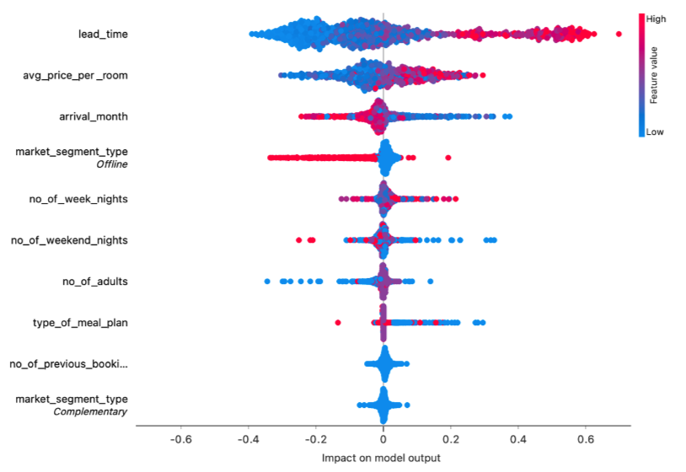
Lead time, price, and arrival month have the largest impact on whether a guest will cancel their room.

Slide 30
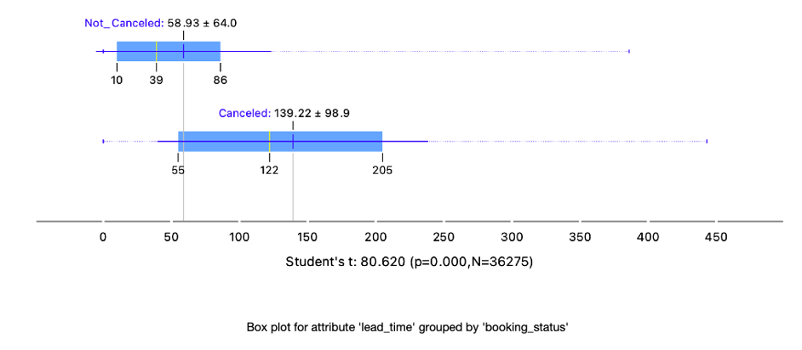
Hotel reservations booked closer to a guest’s arrival date are less likely to be canceled.

Slide 31
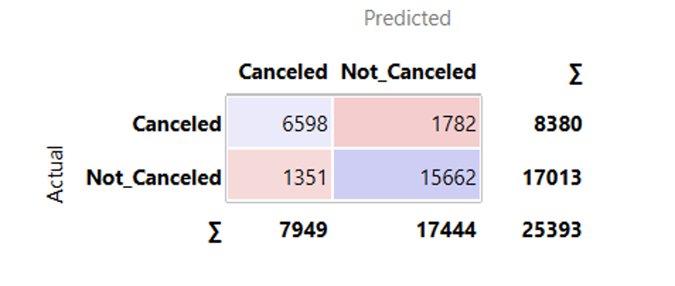
Decision Tree - Confusion Matrix

Slide 32
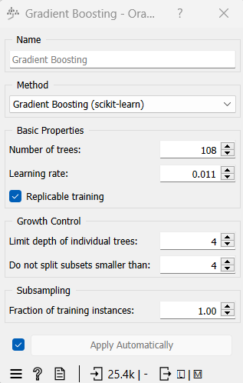
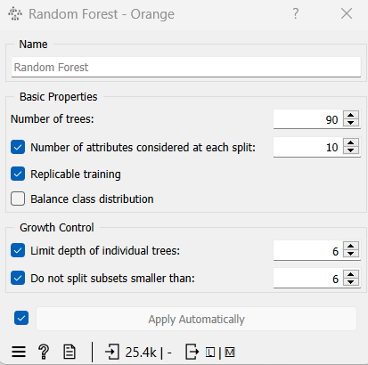
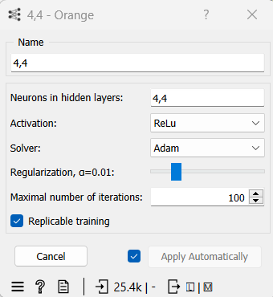
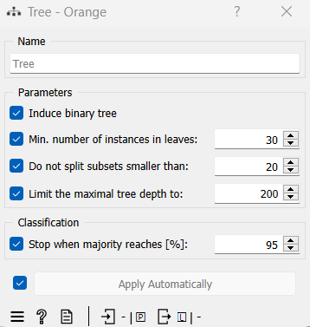
Parameters for Models

